Slide 1

Heart Health Prediction
Madhuri Basava

Slide 2
Heart Health Prevention
Heart disease refers to any condition that impairs the heart’s capacity to function normally.
In recent years, it has become the leading cause of death in the world. Congestive heart failure (CHF) prevalence is expected to rise by 46% by 2030 compared to 2012 rates.
Given a dataset containing various features related to an individual's health and lifestyle (e.g., age, sex, cholesterol levels, blood pressure, etc.), the task is to build a machine-learning model that can predict the presence or absence of heart disease.
The model will be trained on historical data and evaluated for its accuracy and reliability in predicting heart disease in unseen data.

Slide 3
Dataset: Source
The dataset is taken from the Kaggle website. Heart Disease | EDA and Classification | ACC:94.5% (kaggle.com)

Slide 4
Data Understanding
1190 individual’s data
No missing Values

Slide 5
Dataset Features
Age: The age of the individual.
Sex: Gender of the individual.
Chest pain type: type of chest pain experienced.
Resting bp s: resting Blood Pressure in mm Hg
Cholesterol: Serum Cholesterol in mg/dl
Fasting blood sugar: Fasting blood sugar > 120 mg/dl (1 = true; 0 = false).
resting ecg: Results of the resting electrocardiographic test.
max heart rate: Maximum heart rate achieved during exercise
exercise angina: Exercise-induced angina (1 = yes; 0 = no).
old peak: ST depression induced by exercise relative to rest
stslope: Slope of the peak exercise ST segment.
Target: Presence of heart disease (1 = yes, 0 = no).

Slide 6
Questions we want to answer
Can we predict who is more prone to heart disease with the values obtained from our dataset?
What aged people are more susceptible to heart health problems?
Is gender related to heart health issues? Which gender is more affected?
How is the individual’s blood pressure related to heart health
Is Heart disease risk more for individuals with high cholesterol problems?
How is the individual’s blood sugar level related to heart health?
Does chest pain type influence the risk of heart disease?
Do electrocardiographic test results suggest the likelihood of heart disease?
How is heart disease related to Max heart rate?
Is Exercise-induced angina related to heart disease?

Slide 7
Methodology: Data Cleaning
Checked for null values. There are no null values.
Checked the ‘cholesterol’ column which has some zero values. So, dropped those rows.
Dropped the target column.

Slide 8
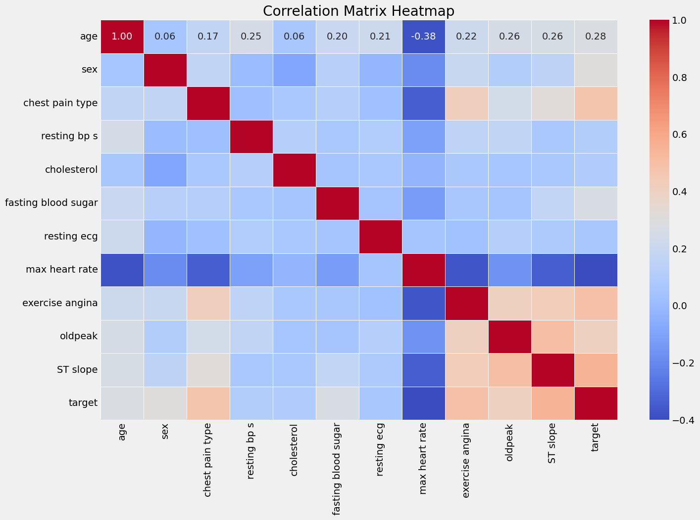
Correlation between the variables

Slide 9
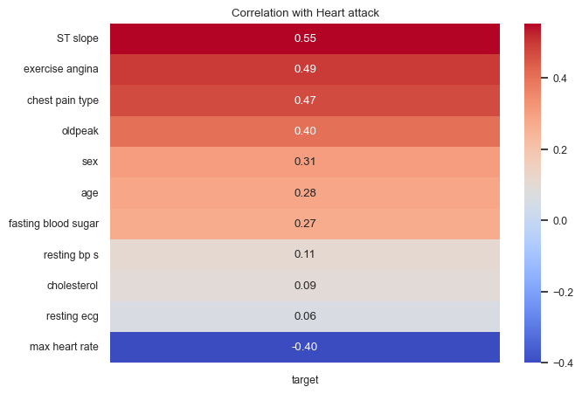
Correlation between the variables

Slide 10
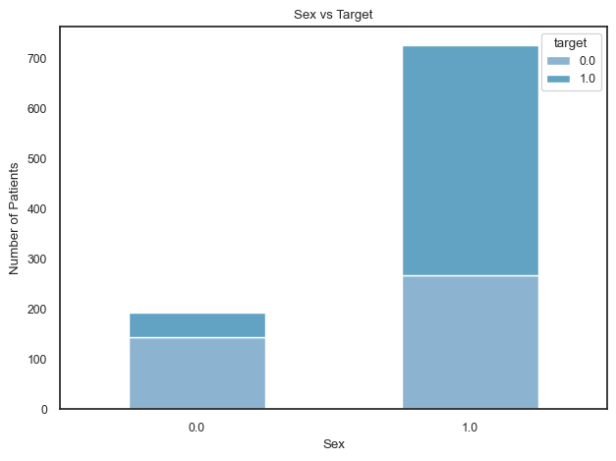
Correlation between the variables

Slide 11
Answers to the questions
In the above graph, 1-Male and 0-Female. Men are generally at higher risk of heart disease than women. However, after menopause, a woman's risk increases to almost match that of men.
Increasing age is a major risk factor for heart disease. The arteries tend to narrow and harden over time, increasing the risk of coronary artery disease, heart attack, and stroke
High levels of (LDL low-density lipoprotein) cholesterol are associated with an increased risk of heart disease, while high levels of HDL (high-density lipoprotein) cholesterol are protective. Cholesterol can build up in the walls of arteries, leading to atherosclerosis.
High fasting blood sugar levels (prediabetes or diabetes) can contribute to the narrowing of the arteries and increase the risk of heart disease. A fasting blood sugar level less than 100 mg/dL is considered normal. 100-125 mg/dL is considered prediabetes, and 126 mg/dL or higher on two separate tests means you have diabetes.
Hypertension (high blood pressure) damages the arteries and makes them more susceptible to plaque buildup, increasing the risk of heart disease and stroke.
Downsloping Peak Exercise ST Segment (ST slope 0.55): The presence of a downsloping peak exercise ST segment in an ECG report is associated with a higher probability of heart disease.
Non-anginal chest pain also shows a significant positive correlation with heart disease.
Exercise-induced angina is associated with a lower likelihood of heart disease.
A high maximum heart rate achieved during testing is associated with a higher likelihood of heart disease.

Slide 12
Steps taken for Modeling
Load the data set into a data frame.
Perform the EDA to understand the characteristics of the data set.
Clean the data set. Remove the unnecessary features.
Evaluate the correlation between the variables in the dataset.
Apply various models to the data set.
Create a confusion matrix to show the performance of each model to evaluate the predicted values from the model vs. the actual values from the test dataset.
Calculate the AUC/ROC score for each model and choose the best model.

Slide 13
Methodology: Algorithms
K Nearest Neighbors
Naïve Bayes Model
Logistic Regression

Slide 14
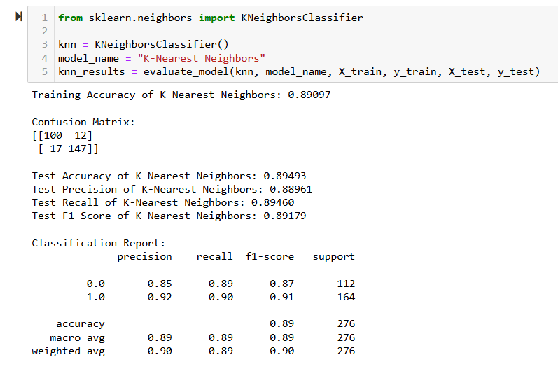
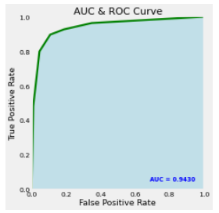
Results: Evaluation
1) K NearestNeighbours Model

Slide 15
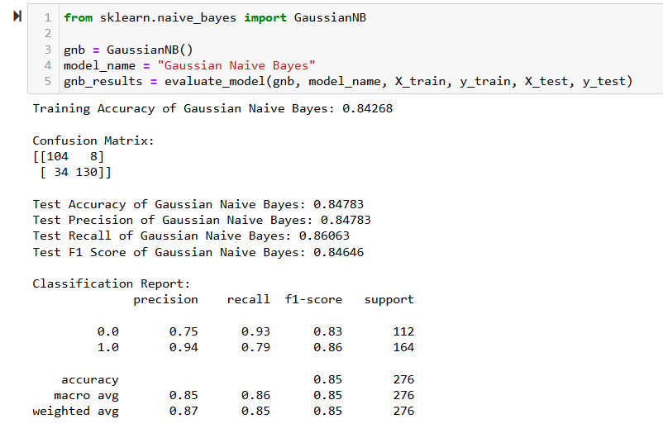
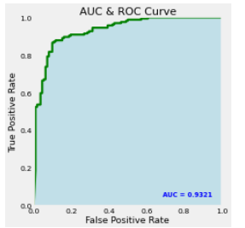
Results: Evaluation
2) Naïve Bayes Model

Slide 16
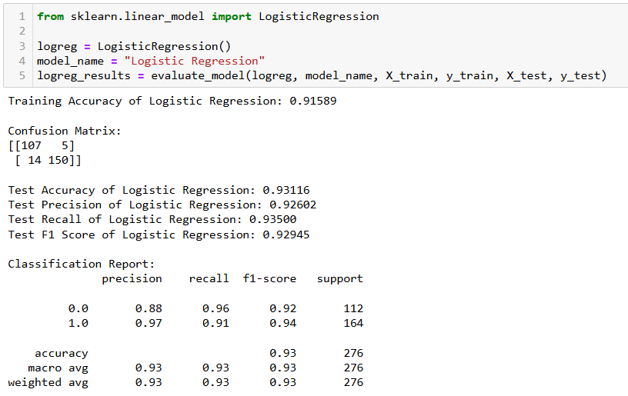
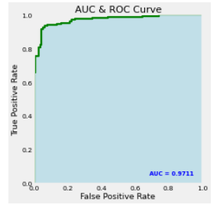
Results: Evaluation
3) Logistic Regression

Slide 17
Conclusion
From the above results, we can infer that the accuracy of the Logistic Regression is around 0.92 which is greater than the accuracy of the K-Nearest Neighbors Model, which is 0.89, and the Naïve Bayes Model which is 0.84.
Also, the Area Under the Curve (AUC) value for KNN is 0.9430, the AUC for Naïve Bayes Model is 0.9321, and the AUC of Logistic regression is 0.9711.
So, we can choose Logistic Regression for modeling.

Slide 18
References
Heart Health Prediction dataset is retrieved from the Kaggle website: Heart Disease | EDA and Classification | ACC:94.5% (kaggle.com)
Article on heart disease: Enhancing heart disease prediction using a self-attention-based transformer model | Scientific Reports (nature.com)
Heart Disease Prediction using Machine Learning | Aman Kharwal (thecleverprogrammer.com)

Slide 19
Thank You

